Slide 1
Database Normalization and Functional Dependency/Transaction
Understanding Normalization, Normal Forms, and Real-time Transaction Applications

Slide 2
Introduction to Functional Dependency
- A functional dependency (FD) is a relationship between attributes in a relational database.
- Denoted as X → Y, meaning Y is functionally dependent on X.
- Used to maintain data integrity and normalization.

Slide 3
Types of Functional Dependencies
1. **Trivial Functional Dependency**
- Example: A → A or AB → A
- The right-hand side is a subset of the left-hand side.
2. **Non-Trivial Functional Dependency**
- Example: A → B (where B is not a subset of A)
- Helps in database normalization.

Slide 4
Armstrong’s Axioms (Rules of FD)
1. **Reflexivity**: If Y is a subset of X, then X → Y.
2. **Augmentation**: If X → Y, then XZ → YZ.
3. **Transitivity**: If X → Y and Y → Z, then X → Z.
4. **Union**: If X → Y and X → Z, then X → YZ.
5. **Decomposition**: If X → YZ, then X → Y and X → Z.
6. **Pseudotransitivity**: If X → Y and WY → Z, then XW → Z.

Slide 5
Example of Functional Dependency in a Table
| Student_ID | Name | Course | Department |
|-----------|--------|--------|------------|
| 101 | Alice | DBMS | CS |
| 102 | Bob | OS | IT |
| 103 | Charlie| DBMS | CS |
Functional Dependencies:
- **Student_ID → Name** (Each Student_ID uniquely identifies a Name)
- **Course → Department** (Each Course belongs to a single Department)

Slide 6
Identifying Functional Dependencies
- Check uniqueness of an attribute.
- Use real-world constraints (e.g., each student has a unique ID).
- Normalize tables to remove redundancy.

Slide 7
Importance of Functional Dependencies
- Helps in **normalization** (1NF, 2NF, 3NF, BCNF).
- Reduces data redundancy.
- Ensures data consistency and integrity.

Slide 8
Introduction to Normalization
- Normalization is the process of organizing data in a database.
- Eliminates redundancy and ensures data dependencies are logical.
- Divides a large table into smaller, related tables.
- Follows a stepwise approach using normal forms.

Slide 9
First Normal Form (1NF)
- A table is in 1NF if:
- All attributes contain atomic (indivisible) values.
- Each column contains values of a single type.
- Each row is unique and identified by a primary key.
**Example (Unnormalized Table):**
| Order_ID | Customer | Items |
|----------|---------|--------------|
| 1 | Alice | Pen, Pencil |
| 2 | Bob | Notebook |
**Solution (1NF Table):**
| Order_ID | Customer | Item |
|----------|---------|---------|
| 1 | Alice | Pen |
| 1 | Alice | Pencil |
| 2 | Bob | Notebook|

Slide 10
Second Normal Form (2NF)
- A table is in 2NF if:
- It is already in 1NF.
- It has no partial dependencies (every non-key attribute depends on the whole primary key).
**Example (1NF Table with Partial Dependency):**
| Order_ID | Item | Supplier | Supplier_City |
|----------|---------|----------|--------------|
| 1 | Pen | ABC Ltd | New York |
| 2 | Pencil | ABC Ltd | New York |
**Problem:**
- Supplier_City depends only on Supplier, not on Order_ID.
**Solution (2NF Table):**
**Orders Table:**
| Order_ID | Item | Supplier |
|----------|---------|----------|
| 1 | Pen | ABC Ltd |
| 2 | Pencil | ABC Ltd |
**Suppliers Table:**
| Supplier | Supplier_City |
|----------|--------------|
| ABC Ltd | New York |

Slide 11
Real-Time Application of Normalization
- Used in **banking systems** to manage customer transactions.
- Applied in **e-commerce platforms** to organize product listings.
- Ensures **efficient data retrieval** in healthcare databases.

Slide 12
Conclusion
- Normalization organizes data efficiently and avoids redundancy.
- Helps in designing scalable databases with better performance.
- Functional dependencies play a key role in achieving normalization.

Slide 13
Normalization
Normalization in DBMS is a technique using which you can organize the data in the database tables so that:
There is less repetition of data,
A large set of data is structured into a bunch of smaller tables,
and the tables have a proper relationship between them.
DBMS Normalization is a systematic approach to decompose (break down) tables to eliminate data redundancy(repetition) and undesirable characteristics like Insertion anomaly in DBMS, Update anomaly in DBMS, and Delete anomaly in DBMS.
It is a multi-step process that puts data into tabular form, removes duplicate data, and set up the relationship between tables.

Slide 14
Why we need Normalization in DBMS?
Normalization is required for, Eliminating redundant(useless) data, therefore handling data integrity, because if data is repeated it increases the chances of inconsistent data.
Normalization helps in keeping data consistent by storing the data in one table and referencing it everywhere else.
Storage optimization although that is not an issue these days because Database storage is cheap.
Breaking down large tables into smaller tables with relationships, so it makes the database structure more scalable and adaptable.
Ensuring data dependencies make sense i.e. data is logically stored.

Slide 15
Types of DBMS Normal forms
Normalization rules are divided into the following normal forms:
First Normal Form
Second Normal Form
Third Normal Form
BCNF

Slide 16
1. First Normal Form (1NF)
For a table to be in the First Normal Form, it should follow the following 4 rules:
It should only have single(atomic) valued attributes/columns.
Values stored in a column should be of the same domain.
All the columns in a table should have unique names.
And the order in which data is stored should not matter.

Slide 17
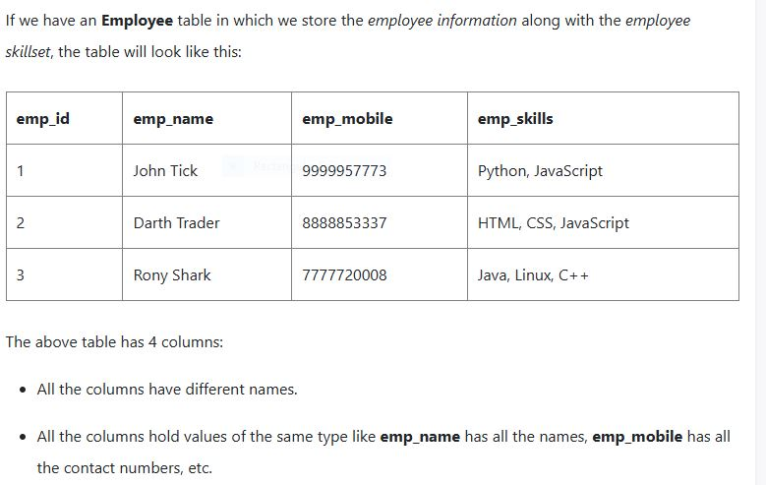

Slide 18
But the emp_skills column holds multiple comma-separated values, while as per the First Normal form, each column should have a single value.
Hence the above table fails to pass the First Normal form.
So how do you fix the above table? There are two ways to do this:
Remove the emp_skills column from the Employee table and keep it in some other table.
Or add multiple rows for the employee and each row is linked with one skill.

Slide 19
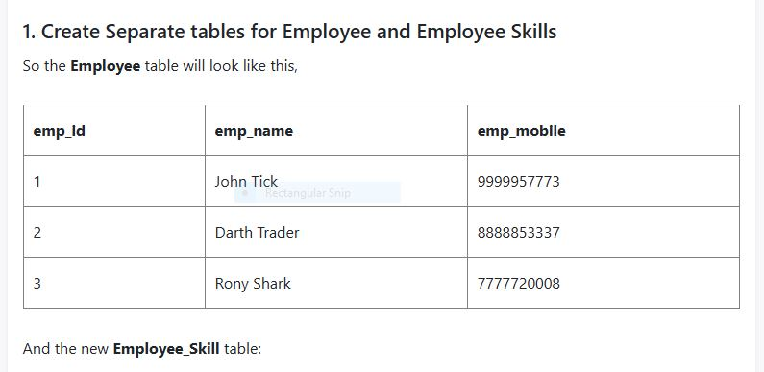

Slide 20
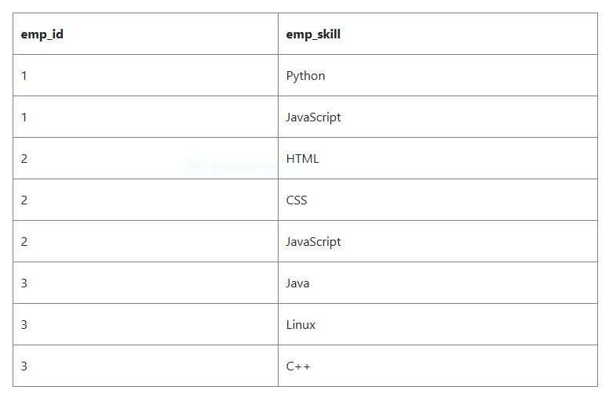

Slide 21
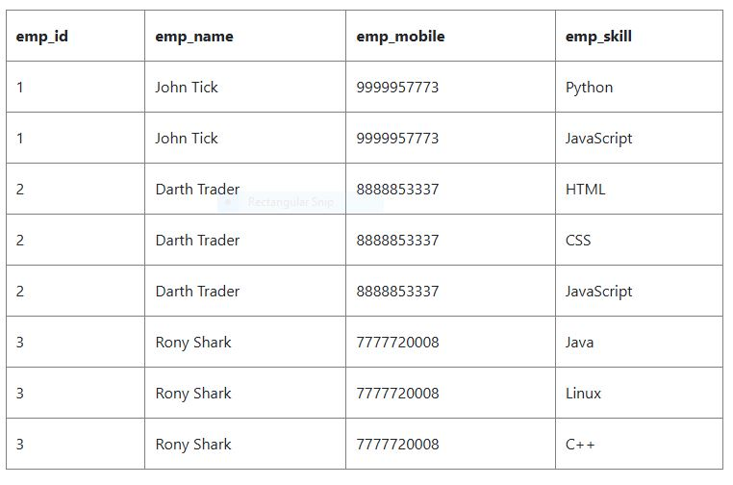
You can also simply add multiple rows to add multiple skills. This will lead to repetition of the data, but that can be handled as you further Normalize your data using the Second Normal form and the Third Normal form.

Slide 22
2. Second Normal Form (2NF)
For a table to be in the Second Normal Form,
It should be in the First Normal form.
And, it should not have Partial Dependency.
What is Partial Dependency?
When a table has a primary key that is made up of two or more columns, then all the columns(not included in the primary key) in that table should depend on the entire primary key and not on a part of it. If any column(which is not in the primary key) depends on a part of the primary key then we say we have Partial dependency in the table.

Slide 23
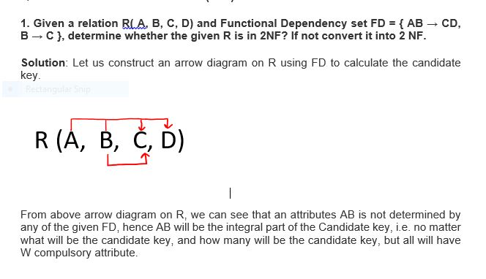

Slide 24
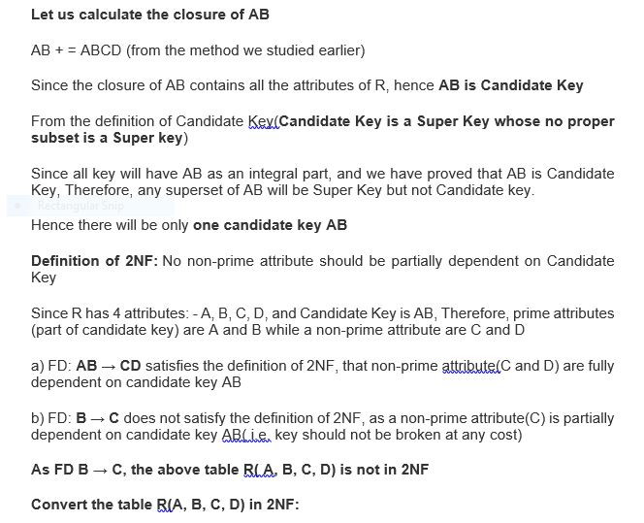

Slide 25
Since FD: B → C, our table was not in 2NF, let's decompose the table
R1(B, C)
Since the key is AB, and from FD AB → CD, we can create R2(A, B, C, D) but this will again have a problem of partial dependency B → C, hence R2(A, B, D).
Finally, the decomposed table which is in 2NF
a) R1( B, C)
b) R2(A, B, D)

Slide 26
3. Given a relation R( P, Q, R, S, T, U, V, W, X, Y) and Functional Dependency set FD = { PQ → R, PS → VW, QS → TU, P → X, W → Y }, determine whether the given R is in 2NF? If not convert it into 2 NF.

Slide 27
Solution
Since due to FD: PQ → R, PS → VW, QS → TU, P → X our table was not in 2NF, let's decompose the table
R1(P, Q, R) (Now in table R1 FD: PQ → R is Full F D, hence R1 is in 2NF)
R2( P, S, V, W) (Now in table R2 FD: PS → VW is Full F D, hence R2 is in 2NF)
R3( Q, S, T, U) (Now in table R3 FD: QS → TU is Full F D, hence R3 is in 2NF)
R4( P, X) (Now in table R4 FD : P → X is Full F D, hence R4 is in 2NF)
R5( W, Y) (Now in table R5 FD: W → Y is Full F D, hence R2 is in 2NF)
And create one table for the key, since the key is PQS.
R6(P, Q, S)
Finally, the decomposed tables which is in 2NF are:
R1(P, Q, R)
R2( P, S, V, W)
R3( Q, S, T, U)
R4( P, X)
R5( W, Y)
R6(P, Q, S)

Slide 28
4. Given a relation R( A, B, C, D, E) and Functional Dependency set FD = { A → B, B → E, C → D}, determine whether the given R is in 2NF? If not convert it into 2 NF.

Slide 29
3NF
To solve the question on 3 NF, we must understand it's both definitions:
Definition 1: A relational schema R is said to be in 3NF, First, it should be in 2NF and, no non-prime attribute should be transitively dependent on the Key of the table.
If X → Y and Y → Z exist then X → Z also exists which is a transitive dependency, and it should not hold.
Definition 2: First it should be in 2NF and if there exists a non-trivial dependency between two sets of attributes X and Y such that X → Y (i.e., Y is not a subset of X) then
Either X is Super Key
Or Y is a prime attribute.

Slide 30
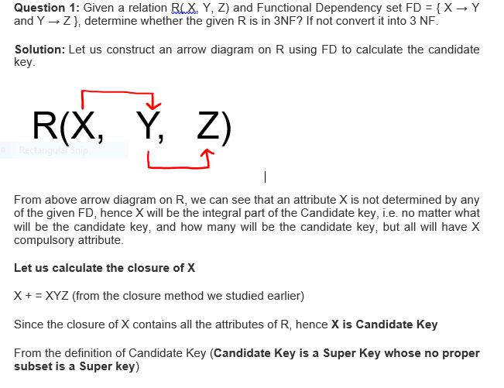

Slide 31
Since all key will have X as an integral part, and we have proved that X is Candidate Key, Therefore, any superset of X will be Super Key but not the Candidate key.
Hence there will be only one candidate key X
Definition of 3NF: A relational schema R is said to be in 3NF, First, it should be in 2NF and, no non-prime attribute should be transitively dependent on the Key of the table.
If X → Y and Y → Z exist then X → Z also exists which is a transitive dependency, and it should not hold.
Since R has 3 attributes: - X, Y, Z, and Candidate Key is X, Therefore, prime attribute (part of candidate key) is X while a non-prime attribute are Y and Z
Given FD are X → Y and Y → Z
So, we can write X → Z (which is a transitive dependency)

Slide 32
In above FD X → Z, a non-prime attribute( Z) is transitively depending on the key of the table( X ) hence as per the definition of 3NF it is not in 3 NF, because no non-prime attribute should be transitively dependent on the key of the table.
Now check the above table is in 2 NF.
FD: X → Y is in 2NF ( as Key is not breaking and its Fully functional dependent )
FD: Y → Z is also in 2NF( as it does not violate the definition of 2NF)
Hence above table R( X, Y, Z ) is in 2NF but not in 3NF.
We can also prove the same from Definition 2: First, it should be in 2NF and if there exists a non-trivial dependency between two sets of attributes X and Y such that X → Y (i.e., Y is not a subset of X) then
Either X is Super Key
Or Y is a prime attribute.

Slide 33
Example
Since we have just proved that above table R is in 2 NF. Let's check it for 3NF using definition 2.
FD: X → Y is in 3NF (as X is a super Key)
FD: Y → Z is not in 3NF (as neither Y is Key nor Z is a prime attribute)
Hence because of Y → Z using definition 2 of 3NF, we can say that above table R is not in 3NF.
Convert the table R( X, Y, Z) into 3NF:
Since due to FD: Y → Z, our table was not in 3NF, let's decompose the table
FD: Y → Z was creating issue, hence one table R1(Y, Z)
Create one Table for key X, R2(X, Y), since X → Y
Hence decomposed tables which are in 3NF are:
R1(X, Y)
R2(Y, Z)

Slide 34
Question 2: Given a relation R( X, Y, Z, W, P) and Functional Dependency set FD = { X → Y, Y → P, and Z → W}, determine whether the given R is in 3NF? If not convert it into 3 NF.

Slide 35
BCNF
BCNF is the advance version of 3NF. It is stricter than 3NF.
A table is in BCNF if every functional dependency X → Y, X is the super key of the table.
For BCNF, the table should be in 3NF, and for every FD, LHS is super key.
Example: Let's assume there is a company where employees work in more than one department.

Slide 36
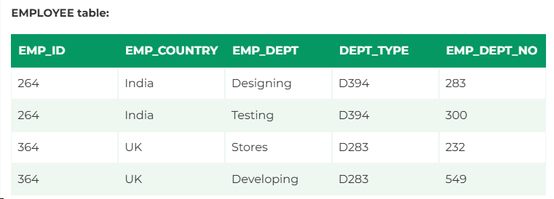
EMPLOYEE table:

Slide 37
In the above table Functional dependencies are as follows:
EMP_ID → EMP_COUNTRY
EMP_DEPT → {DEPT_TYPE, EMP_DEPT_NO}
Candidate key: {EMP-ID, EMP-DEPT}
The table is not in BCNF because neither EMP_DEPT nor EMP_ID alone are keys.
To convert the given table into BCNF, we decompose it into three tables:

Slide 38
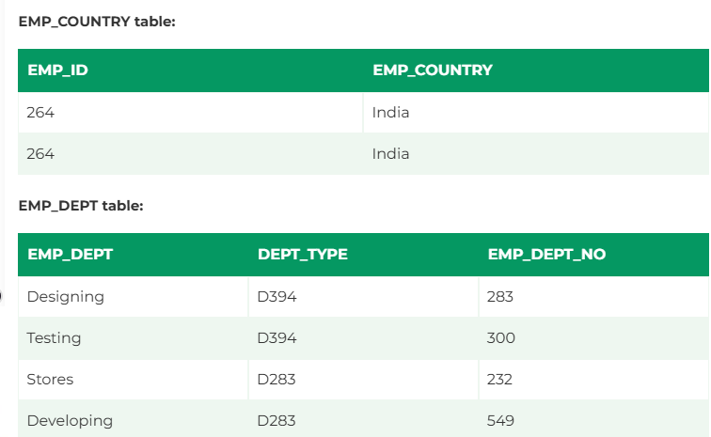

Slide 39
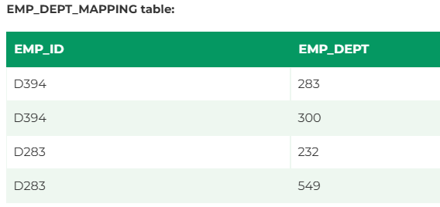

Slide 40
Functional dependencies:
EMP_ID → EMP_COUNTRY
EMP_DEPT → {DEPT_TYPE, EMP_DEPT_NO}
Candidate keys:
For the first table: EMP_ID For the second table: EMP_DEPT For the third table: {EMP_ID, EMP_DEPT}
Now, this is in BCNF because left side part of both the functional dependencies is a key.

Slide 41
Fourth Normal Form (4NF) with Example
Definition
A table is in Fourth Normal Form (4NF) if it is already in Third Normal Form (3NF) and has no multi-valued dependencies. A multi-valued dependency occurs when one attribute in a table is dependent on another, but they are independent of other attributes.
Example
Consider a table that stores information about students, courses, and sports activities:
Student Course Sport
Alice Math Tennis
Alice Math Swimming
Alice Physics Tennis
Bob Math Tennis

Slide 42
Here, the Course and Sport are independent of each other but depend on Student, creating a multi-valued dependency. To achieve 4NF, we decompose it into two separate tables:
Student-Course Table:
Student Course
Alice Math
Alice Physics
Bob Math
Student-Sport Table:
Student Sport
Alice Tennis
Alice Swimming
Bob Tennis
Now, each table has no multi-valued dependency, achieving 4NF.

Slide 43
Fifth Normal Form (5NF) with Example
Definition
Fifth Normal Form (5NF), also known as Project-Join Normal Form (PJNF), ensures that a database table is free from join dependency anomalies. A table is in 5NF if it is already in 4NF, and it cannot be further decomposed without losing information.
Example
Consider a table storing information about consultants, projects, and skills:
Consultant Project Skill
Alice P1 Java
Alice P2 Python
Bob P1 Python
Bob P2 SQL

Slide 44
This table has a join dependency, meaning we cannot split it further without losing data. However, if we find that a consultant’s skills and assigned projects are independent of each other, we can decompose it into two tables:
Consultant-Skill Table:
Consultant Skill
Alice Java
Alice Python
Bob Python
Bob SQL
Consultant-Project Table:
Consultant Project
Alice P1
Alice P2
Bob P1
Bob P2
Now, by joining these two tables, we can recreate the original table without redundancy, achieving 5NF.

Slide 45
4NF Ex
Example 2: Using an Intersection Table to Eliminate MVDs
In a scenario where two attributes, say Courses and Instructors, both have multiple values and are multivalued, we can use an intersection table to eliminate the MVDs.
For example, consider the following table:
CourseID Instructor Student
CS101 Dr. Smith Alice
CS101 Dr. Smith Bob
CS102 Dr. Brown Alice
CS102 Dr. Brown Carol
In this table, a Course can have multiple Instructors, and an Instructor can teach multiple Courses, which creates a multivalued dependency. To achieve 4NF, we can create an intersection table that eliminates the MVD:
1. Courses Table:
CourseID Instructor
CS101 Dr. Smith
CS102 Dr. Brown
2. Course_Student Table:
CourseID Student
CS101 Alice
CS101 Bob
CS102 Alice
CS102 Carol
By creating separate tables and using the intersection table, we eliminate the multivalued dependency and achieve 4NF.
In both examples, 4NF ensures that there are no multivalued dependencies in the database schema, which helps maintain data integrity and reduces redundancy.

Slide 46
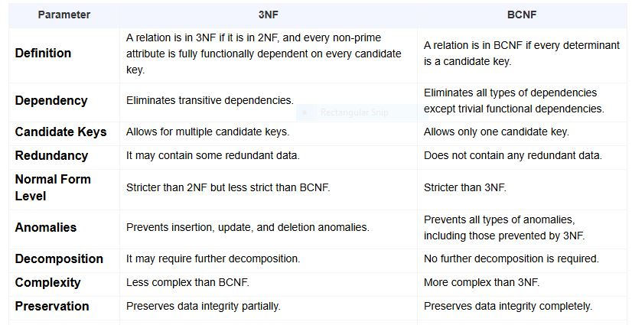

Slide 47
SET Operations in SQL
SQL supports few Set operations which can be performed on the table data. These are used to get meaningful results from data stored in the table, under different special conditions.
In this tutorial, we will cover 4 different types of SET operations, along with example:
UNION
UNION ALL
INTERSECT
MINUS

Slide 48
UNION Operation
UNION is used to combine the results of two or more SELECT statements. However it will eliminate duplicate rows from its resultset. In case of union, number of columns and datatype must be same in both the tables, on which UNION operation is being applied.

Slide 49
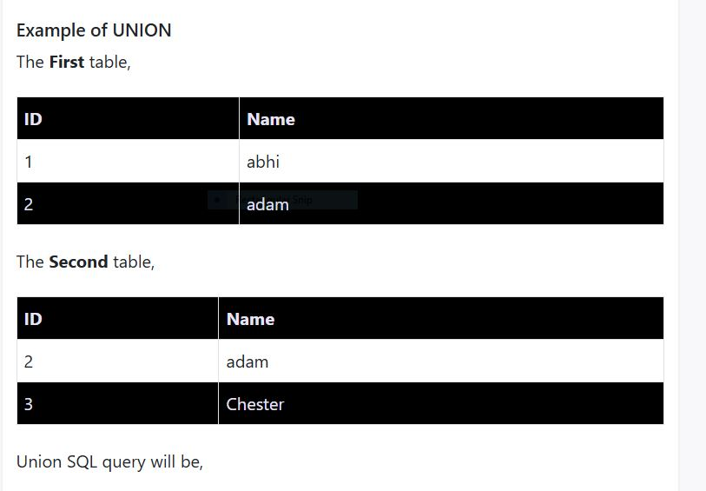

Slide 50
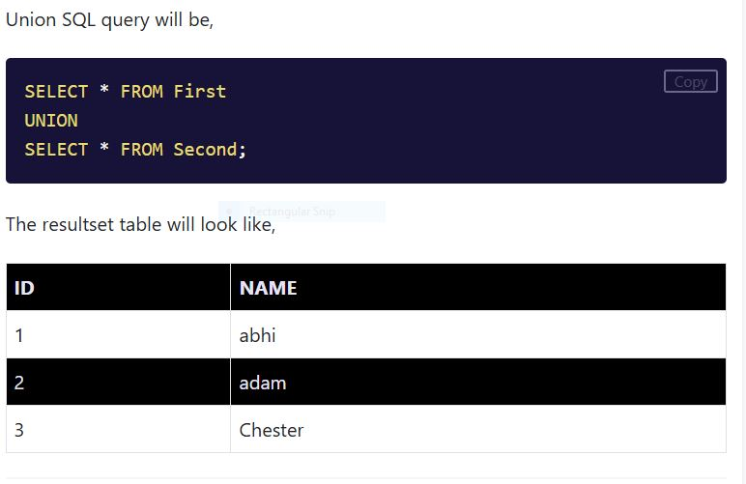

Slide 51
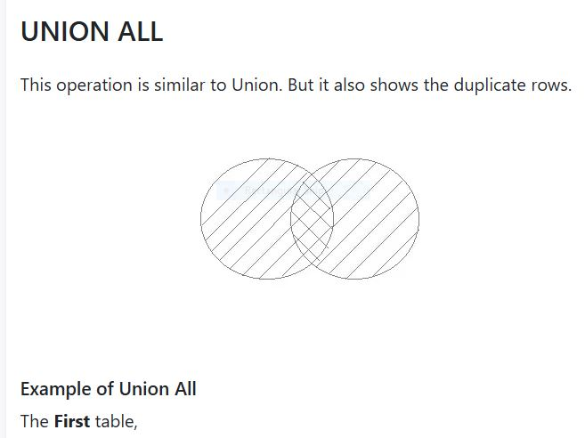

Slide 52
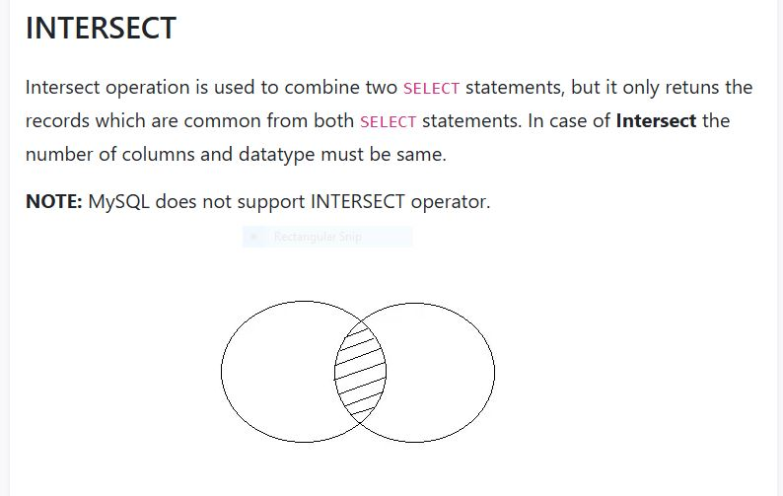

Slide 53
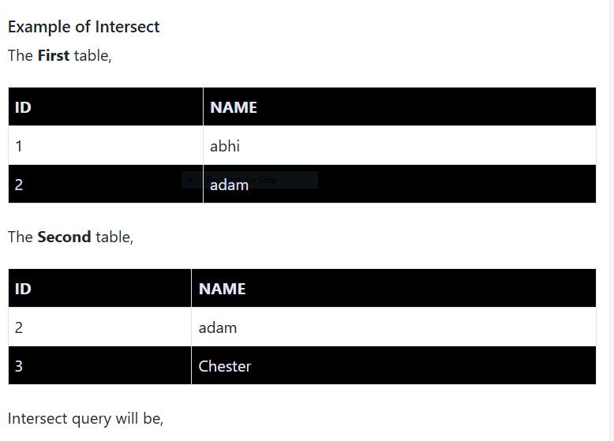

Slide 54
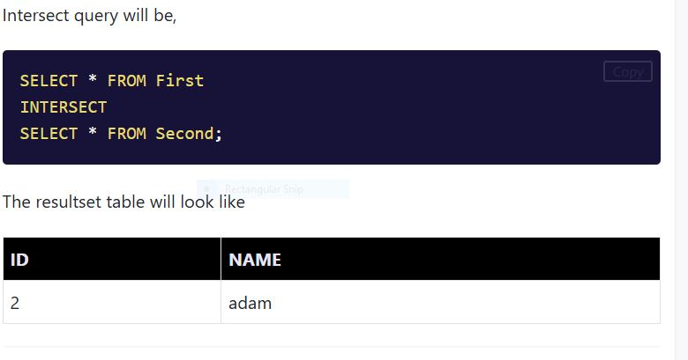

Slide 55
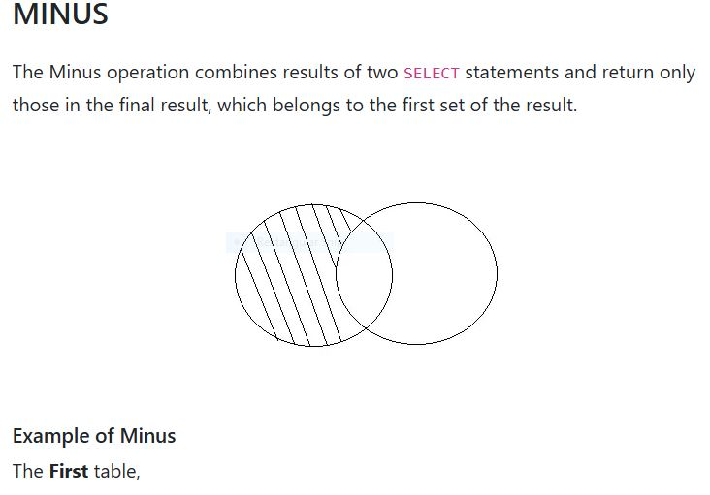

Slide 56
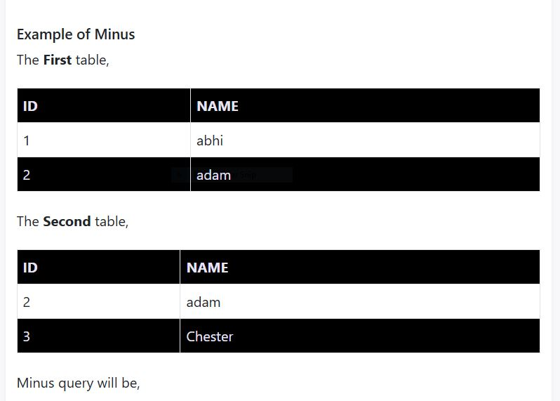

Slide 57
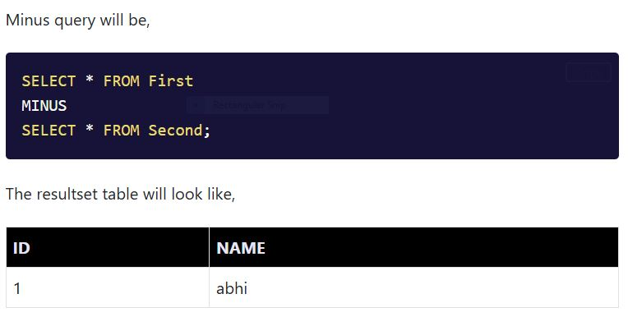

Slide 58
Q&A
- Any questions?

Slide 59
Atomicity: A transaction is either fully completed or not executed at all (all-or-nothing principle).
Consistency: A transaction maintains database integrity by ensuring data validity before and after execution.
Isolation: Each transaction executes independently of other transactions, preventing data anomalies.
Durability: Once a transaction is committed, its changes are permanently stored in the database, even in case of system failures.

Slide 60
Consider a banking transaction where a user transfers $500 from Account A to Account B:
BEGIN TRANSACTION;
UPDATE Accounts SET balance = balance - 500 WHERE account_id = 'A';
UPDATE Accounts SET balance = balance + 500 WHERE account_id = 'B';
COMMIT;
If an error occurs between the two updates, the transaction is rolled back, ensuring that money is not deducted from one account without being credited to the other.

Slide 61
Concurrency Problems in DBMS-
When multiple transactions execute concurrently in an uncontrolled or unrestricted manner, then it might lead to several problems. Such problems are called as concurrency problems.

Slide 62
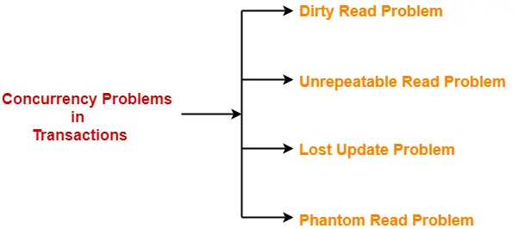

Slide 63
Operations in Transaction-
The main operations in a transaction are-
Read Operation
Write Operation
1. Read Operation-
Read operation reads the data from the database and then stores it in the buffer in main memory.
For example- Read(A) instruction will read the value of A from the database and will store it in the buffer in main memory.
2. Write Operation-
Write operation writes the updated data value back to the database from the buffer.
For example- Write(A) will write the updated value of A from the buffer to the

Slide 64
Transaction States-
A transaction goes through many different states throughout its life cycle.
These states are called as transaction states.
Transaction states are as follows-
Active state
Partially committed state
Committed state
Failed state
Aborted state
Terminated state

Slide 65
1. Active State-
This is the first state in the life cycle of a transaction.
A transaction is called in an active state as long as its instructions are getting executed.
All the changes made by the transaction now are stored in the buffer in main memory.
2. Partially Committed State-
After the last instruction of transaction has executed, it enters into a partially committed state.
After entering this state, the transaction is considered to be partially committed.
It is not considered fully committed because all the changes made by the transaction are still stored in the buffer in main memory.
3. Committed State-
After all the changes made by the transaction have been successfully stored into the database, it enters into a committed state.
Now, the transaction is considered to be fully committed.
NOTE-
After a transaction has entered the committed state, it is not possible to roll back the transaction.
In other words, it is not possible to undo the changes that has been made by the transaction.
This is because the system is updated into a new consistent state.
The only way to undo the changes is by carrying out another transaction called as compensating transaction that performs the reverse operations.

Slide 66
4. Failed State-
When a transaction is getting executed in the active state or partially committed state and some failure occurs due to which it becomes impossible to continue the execution, it enters into a failed state.
5. Aborted State-
After the transaction has failed and entered into a failed state, all the changes made by it have to be undone.
To undo the changes made by the transaction, it becomes necessary to roll back the transaction.
After the transaction has rolled back completely, it enters into an aborted state.
6. Terminated State-
This is the last state in the life cycle of a transaction.
After entering the committed state or aborted state, the transaction finally enters into a terminated state where its life cycle finally comes to an end.

Slide 67
Write-Read Conflict :-Dirty Read Problem
Read-write Conflict:-Un repeatable problem

Slide 68
Conflict Pair
RAR Is not a Conflict Pair
RAW (Read After Write) / True Data Dependency:
This occurs when an instruction needs to read a value that a previous instruction is about to write. It's a true data dependency because the later instruction's execution depends on the result of the earlier instruction.
Example:
Instruction 1: ADD R1, R2, R3 (Writes R1)
Instruction 2: SUB R4, R1, R5 (Reads R1)
WAR (Write After Read) / Anti-Dependency:
This happens when an instruction tries to write to a register that another instruction is about to read, before the read instruction has completed. It's an anti-dependency because the later write could potentially overwrite a value that the first read instruction is waiting for.
Example:
Instruction 1: ADD R1, R2, R3 (Reads R2)
Instruction 2: SUB R2, R4, R5 (Writes R2)
WAW (Write After Write) / Output Dependency:
This arises when two instructions attempt to write to the same register, but in a different order than they were issued. It's an output dependency because the final result of one instruction might be overwritten by the other.
Example:
Instruction 1: ADD R1, R2, R3 (Writes R1)
Instruction 2: SUB R1, R4, R5 (Writes R1)

Slide 69
Checking Whether a Schedule is Conflict Serializable Or Not-
Follow the following steps to check whether a given non-serial schedule is conflict serializable or not-
Step-01:
Find and list all the conflicting operations.
Step-02:
Start creating a precedence graph by drawing one node for each transaction.
Step-03:
Draw an edge for each conflict pair such that if X_{i} (V) and Y_{j} (V) forms a conflict pair then draw an edge from T_{i} to T_{j}.
This ensures that T_{i} gets executed before T_{j}.
Step-04:
Check if there is any cycle formed in the graph.
If there is no cycle found, then the schedule is conflict serializable otherwise not.
NOTE-
By performing the Topological Sort of the Directed Acyclic Graph so obtained, the corresponding serial schedule(s) can be found.
Such schedules can be more than 1.
Conflict Serializability-
Before you go through this article, make sure that you have gone through the previous article on Conflict Serializability.
We have discussed-
The concept of serializability helps to identify the correct non-serial schedules that will maintain the consistency of the database.

Slide 70
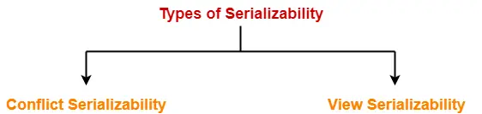

Slide 71
Problem-01: Check whether the given schedule S is conflict serializable or not- S : R₁(A) , R₂(A) , R₁(B) , R₂(B) , R₃(B) , W₁(A) , W₂(B)
Solution-
Step-01:
List all the conflicting operations and determine the dependency between the transactions-
R₂(A) , W₁(A) (T₂ → T₁)
R₁(B) , W₂(B) (T₁ → T₂)
R₃(B) , W₂(B) (T₃ → T₂)
Step-02:
Draw the precedence graph-

Slide 72
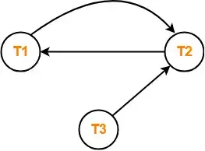
Clearly, there exists a cycle in the precedence graph.
Therefore, the given schedule S is not conflict serializable.

Slide 73
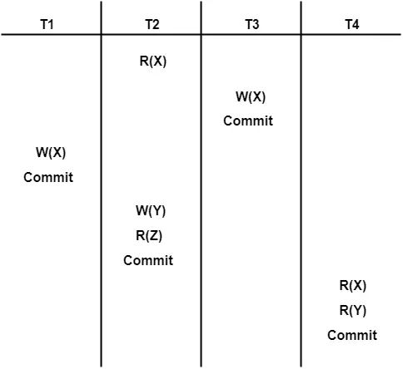
Problem-02: Check whether the given schedule S is conflict serializable and recoverable or not-

Slide 74
Solution-
Checking Whether S is Conflict Serializable Or Not-
Step-01:
List all the conflicting operations and determine the dependency between the transactions-
R₂(X) , W₃(X) (T₂ → T₃)
R₂(X) , W₁(X) (T₂ → T₁)
W₃(X) , W₁(X) (T₃ → T₁)
W₃(X) , R₄(X) (T₃ → T₄)
W₁(X) , R₄(X) (T₁ → T₄)
W₂(Y) , R₄(Y) (T₂ → T₄)
Step-02:
Draw the precedence graph-

Slide 75
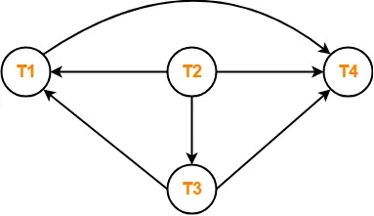

Slide 76
Clearly, there exists no cycle in the precedence graph.
Therefore, the given schedule S is conflict serializable.
Checking Whether S is Recoverable Or Not-
Conflict serializable schedules are always recoverable.
Therefore, the given schedule S is recoverable.
Alternatively,
There exists no dirty read operation.
This is because all the transactions which update the values commits immediately.
Therefore, the given schedule S is recoverable.
Also, S is a Cascadeless Schedule.

Slide 77
Non-Serializable Schedules-
A non-serial schedule which is not serializable is called as a non-serializable schedule.
A non-serializable schedule is not guaranteed to produce the the same effect as produced by some serial schedule on any consistent database.
Characteristics-
Non-serializable schedules-
may or may not be consistent
may or may not be recoverable
Irrecoverable Schedules-
If in a schedule,
A transaction performs a dirty read operation from an uncommitted transaction
And commits before the transaction from which it has read the value
then such a schedule is known as an Irrecoverable Schedule.

Slide 78
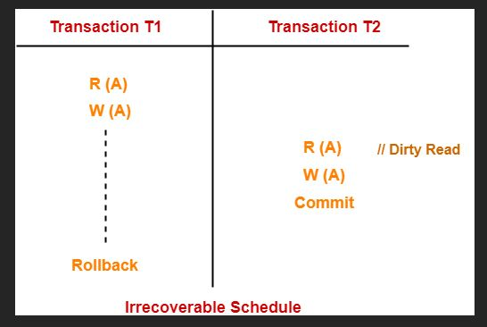
Example- Consider the following schedule-

Slide 79
Here,
T2 performs a dirty read operation.
T2 commits before T1.
T1 fails later and roll backs.
The value that T2 read now stands to be incorrect.
T2 can not recover since it has already committed.
Recoverable Schedules-
If in a schedule,
A transaction performs a dirty read operation from an uncommitted transaction
And its commit operation is delayed till the uncommitted transaction either commits or roll backs
then such a schedule is known as a Recoverable Schedule.
Here,
The commit operation of the transaction that performs the dirty read is delayed.
This ensures that it still has a chance to recover if the uncommitted transaction fails later.

Slide 80
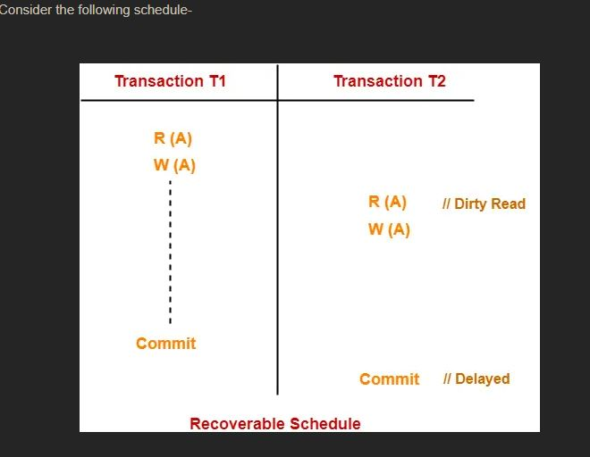
Example-

Slide 81
Here,
T2 performs a dirty read operation.
The commit operation of T2 is delayed till T1 commits or roll backs.
T1 commits later.
T2 is now allowed to commit.
In case, T1 would have failed, T2 has a chance to recover by rolling back.
Checking Whether a Schedule is Recoverable or Irrecoverable-
Method-01:
Check whether the given schedule is conflict serializable or not.
If the given schedule is conflict serializable, then it is surely recoverable. Stop and report your answer.
If the given schedule is not conflict serializable, then it may or may not be recoverable. Go and check using other methods.
Thumb Rules
All conflict serializable schedules are recoverable.
All recoverable schedules may or may not be conflict serializable.

Slide 82
Method-02:
Check if there exists any dirty read operation.
(Reading from an uncommitted transaction is called as a dirty read)
If there does not exist any dirty read operation, then the schedule is surely recoverable. Stop and report your answer.
If there exists any dirty read operation, then the schedule may or may not be recoverable.
If there exists a dirty read operation, then follow the following cases-
Case-01:
If the commit operation of the transaction performing the dirty read occurs before the commit or abort operation of the transaction which updated the value, then the schedule is irrecoverable.
Case-02:
If the commit operation of the transaction performing the dirty read is delayed till the commit or abort operation of the transaction which updated the value, then the schedule is recoverable.
Thumb Rule
No dirty read means a recoverable schedule.

Slide 83
Recoverability-
Before you go through this article, make sure that you have gone through the previous article on Recoverability in DBMS.
We have discussed-
Non-serial schedules which are not serializable are called as non-serializable schedules.
Non-serializable schedules may be recoverable or irrecoverable.
Recoverable Schedules-
If in a schedule,
A transaction performs a dirty read operation from an uncommitted transaction
And its commit operation is delayed till the uncommitted transaction either commits or roll backs
then such a schedule is called as a Recoverable Schedule.
Types of Recoverable Schedules-
A recoverable schedule may be any one of these kinds-

Slide 84
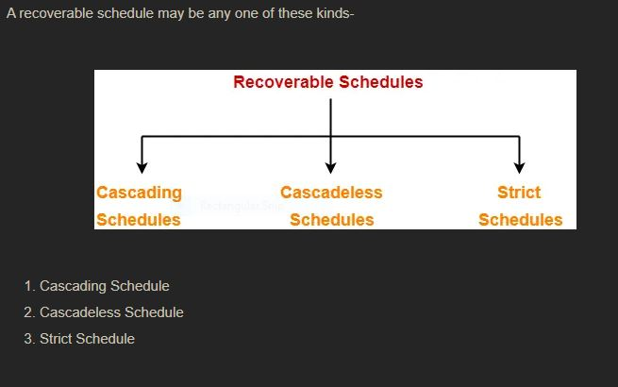

Slide 85
Cascading Schedule-
If in a schedule, failure of one transaction causes several other dependent transactions to rollback or abort, then such a schedule is called as a Cascading Schedule or Cascading Rollback or Cascading Abort.
It simply leads to the wastage of CPU time.
Example-

Slide 86
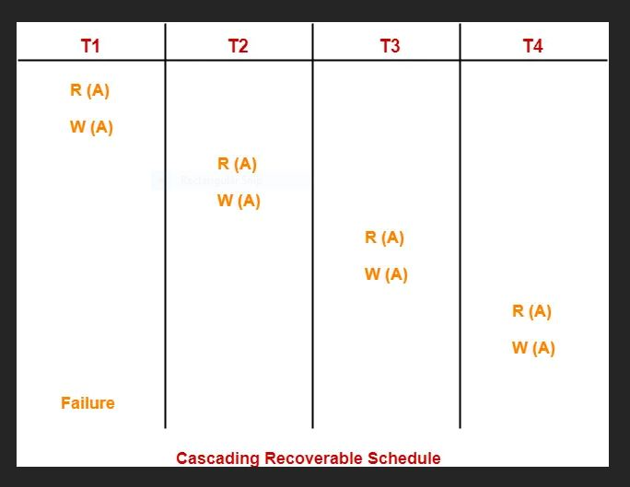

Slide 87
Here,
Transaction T2 depends on transaction T1.
Transaction T3 depends on transaction T2.
Transaction T4 depends on transaction T3.

Slide 88
In this schedule,
The failure of transaction T1 causes the transaction T2 to rollback.
The rollback of transaction T2 causes the transaction T3 to rollback.
The rollback of transaction T3 causes the transaction T4 to rollback.
Such a rollback is called as a Cascading Rollback.
NOTE-
If the transactions T2, T3 and T4 would have committed before the failure of transaction T1, then the schedule would have been irrecoverable.
Cascadeless Schedule-
If in a schedule, a transaction is not allowed to read a data item until the last transaction that has written it is committed or aborted, then such a schedule is called as a Cascadeless Schedule.
In other words, Cascadeless schedule allows only committed read operations.
Therefore, it avoids cascading roll back and thus saves CPU time.

Slide 89
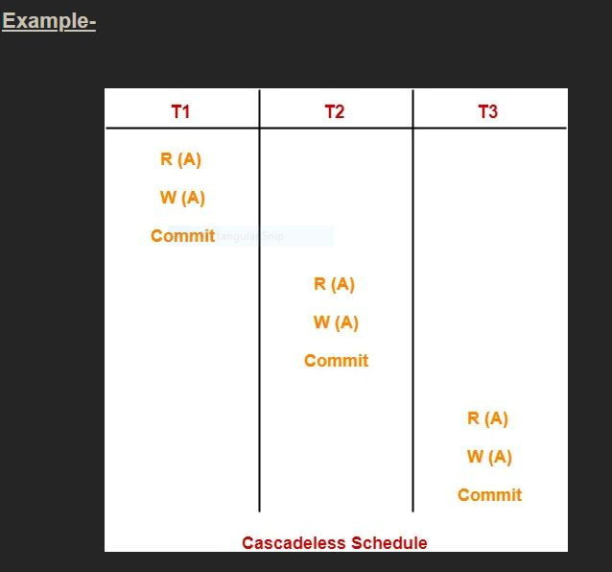

Slide 90
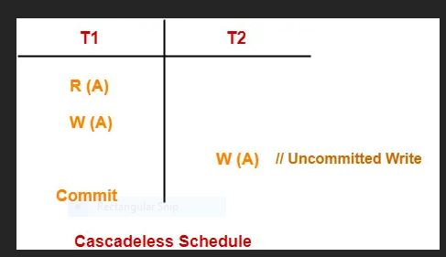
NOTE-
Cascadeless schedule allows only committed read operations.
However, it allows uncommitted write operations.
Example-

Slide 91
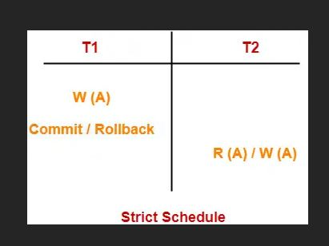
Strict Schedule-If in a schedule, a transaction is neither allowed to read nor write a data item until the last transaction that has written it is committed or aborted, then such a schedule is called as a Strict Schedule.
In other words,
Strict schedule allows only committed read and write operations.
Clearly, strict schedule implements more restrictions than cascadeless schedule.
Example-

Slide 92
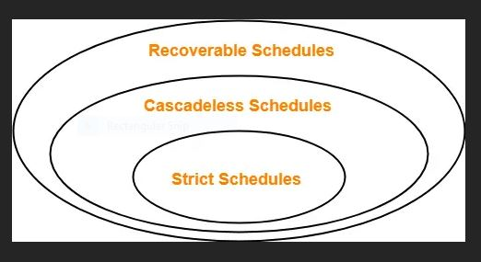
Remember-
Strict schedules are more strict than cascadeless schedules.
All strict schedules are cascadeless schedules.
All cascadeless schedules are not strict schedules.

Slide 94
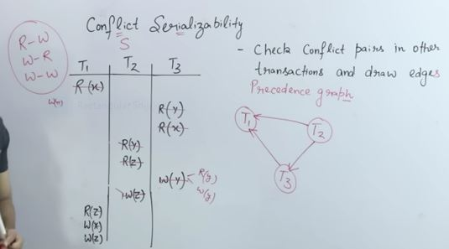
Serially check one by by one in order every Transaction

Slide 95
Once we find No Loop Or Cycle then it is conflict serializable
Serializable
Consistent

Slide 96
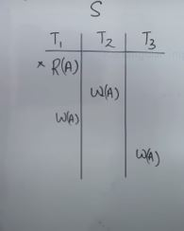
Example:-Check whether a schedule is Conflict serializable(CS) or Non conflict Serializable(NCS)

Slide 97
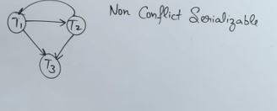
As there is loop so NCS,And we can’t predict is there any serial schedule present for this or not so we can check for View serilizability.

Slide 98
Dirty Read Problem
This read is called as dirty read because-
There is always a chance that the uncommitted transaction might roll back later.Thus, uncommitted transaction might make other transactions read a value that does not even exist.
This leads to inconsistency of the database.
NOTE-
Dirty read does not lead to inconsistency always.
It becomes problematic only when the uncommitted transaction fails and roll backs later due to some reason.

Slide 99
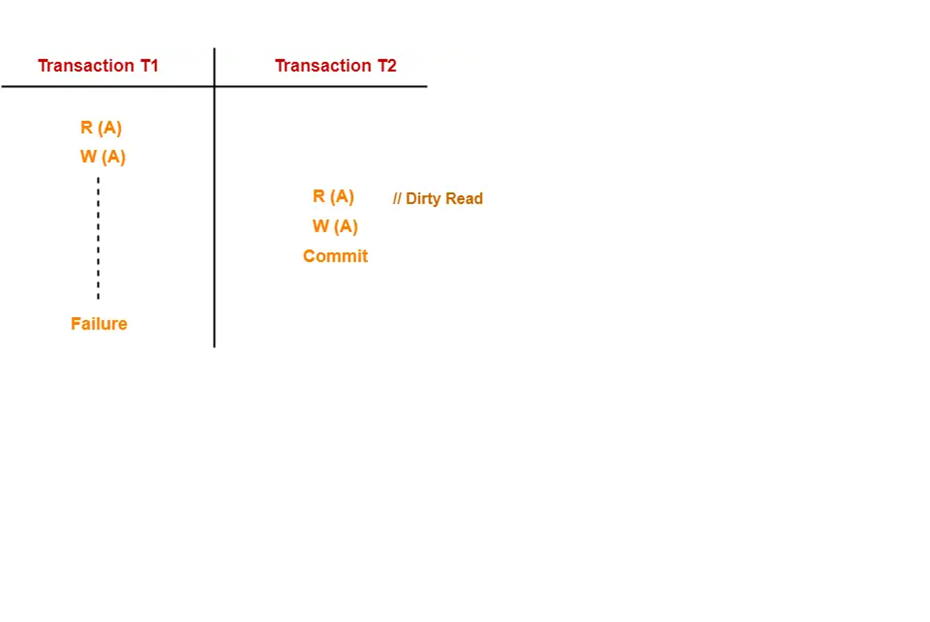

Slide 100
Here,
T1 reads the value of A.
T1 updates the value of A in the buffer.
T2 reads the value of A from the buffer.
T2 writes the updated the value of A.
T2 commits.
T1 fails in later stages and rolls back.
In this example,
T2 reads the dirty value of A written by the uncommitted transaction T1.
T1 fails in later stages and roll backs.
Thus, the value that T2 read now stands to be incorrect.
Therefore, database becomes inconsistent.

Slide 101
Unrepeatable Read Problem
This problem occurs when a transaction gets to read unrepeated i.e. different values of the same variable in its different read operations even when it has not updated its value.
Example-
Here,
T1 reads the value of A.
T1 updates the value of A in the buffer.
T2 reads the value of A from the buffer.
T2 writes the updated the value of A.
T2 commits.
T1 fails in later stages and rolls back.
In this example,
T2 reads the dirty value of A written by the uncommitted transaction T1.
T1 fails in later stages and roll backs.
Thus, the value that T2 read now stands to be incorrect.
Therefore, database becomes inconsistent.
Lost Update Problem
Phantom Read Problem

Slide 102
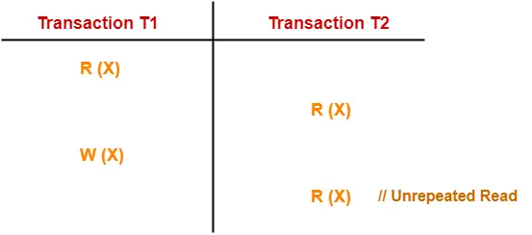
Contd…
This problem occurs when a transaction gets to read unrepeated i.e. different values of the same variable in its different read operations even when it has not updated its value.

Slide 103
Contd..
Here,
T1 reads the value of X (= 10 say).
T2 reads the value of X (= 10).
T1 updates the value of X (from 10 to 15 say) in the buffer.
T2 again reads the value of X (but = 15).
In this example,
T2 gets to read a different value of X in its second reading.
T2 wonders how the value of X got changed because according to it, it is running in isolation.

Slide 104
Lost Update Problem-
This problem occurs when multiple transactions execute concurrently and updates from one or more transactions get lost.

Slide 105
Here,
T1 reads the value of A (= 10 say).
T2 updates the value to A (= 15 say) in the buffer.
T2 does blind write A = 25 (write without read) in the buffer.
T2 commits.
When T1 commits, it writes A = 25 in the database.
In this example,
T1 writes the over written value of X in the database.
Thus, update from T1 gets lost.
NOTE-
This problem occurs whenever there is a write-write conflict.
In write-write conflict, there are two writes one by each transaction on the same data item without any read in the middle.

Slide 106
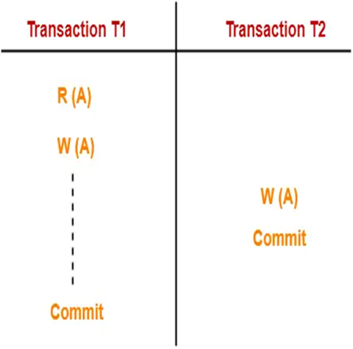

Slide 107
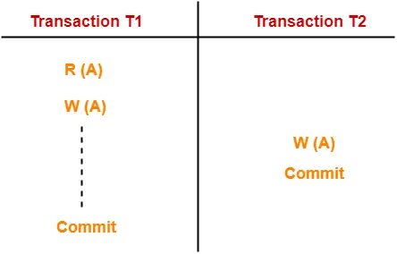
4. Phantom Read Problem-
This problem occurs when a transaction reads some variable from the buffer and when it reads the same variable later, it finds that the variable does not exist.

Slide 108
Here,
T1 reads X.
T2 reads X.
T1 deletes X.
T2 tries reading X but does not find it.
In this example,
T2 finds that there does not exist any variable X when it tries reading X again.
T2 wonders who deleted the variable X because according to it, it is running in isolation.

Slide 109
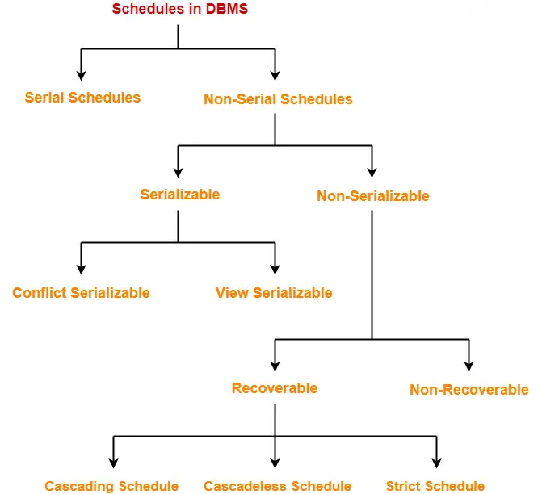

Slide 110
Serial Schedules-
In serial schedules,
All the transactions execute serially one after the other.
When one transaction executes, no other transaction is allowed to execute.
Characteristics-
Serial schedules are always- Consistent
Recoverable
Cascadeless
Strict

Slide 111
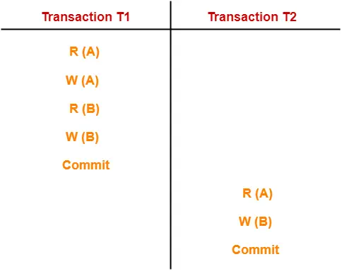
Serial Schedule

Slide 112
In this schedule,
There are two transactions T1 and T2 executing serially one after the other.
Transaction T1 executes first.
After T1 completes its execution, transaction T2 executes.
So, this schedule is an example of a Serial Schedule.

Slide 113
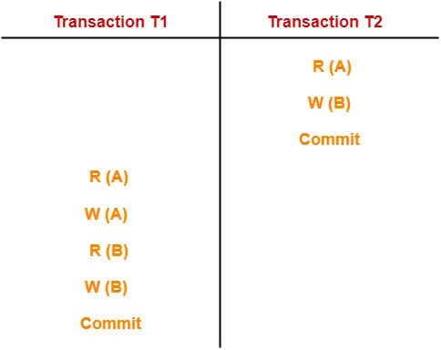

Slide 114
In this schedule,
There are two transactions T1 and T2 executing serially one after the other.
Transaction T2 executes first.
After T2 completes its execution, transaction T1 executes.
So, this schedule is an example of a Serial Schedule.

Slide 115
Non-Serial Schedules-
In non-serial schedules,
Multiple transactions execute concurrently.
Operations of all the transactions are inter leaved or mixed with each other.
Characteristics-
Non-serial schedules are NOT always-
Consistent
Recoverable
Cascade less
Strict

Slide 116
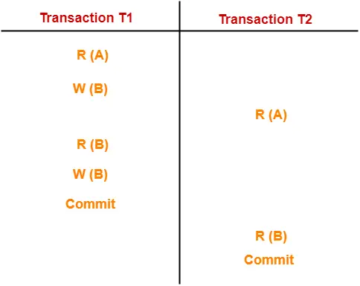
In this schedule, There are two transactions T1 and T2 executing concurrently. The operations of T1 and T2 are interleaved. So, this schedule is an example of a Non-Serial Schedule.

Slide 117
Conflict Serializability-
If a given non-serial schedule can be converted into a serial schedule by swapping its non-conflicting operations, then it is called as a conflict serializable schedule.
Conflicting Operations-
Two operations are called as conflicting operations if all the following conditions hold true for them-
Both the operations belong to different transactions
Both the operations are on the same data item
At least one of the two operations is a write operation

Slide 118
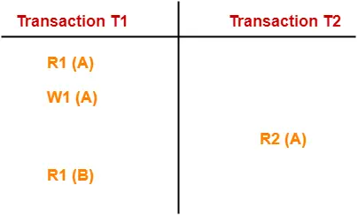

Slide 119
In this schedule,
W1 (A) and R2 (A) are called as conflicting operations.
This is because all the above conditions hold true for them.

Slide 120
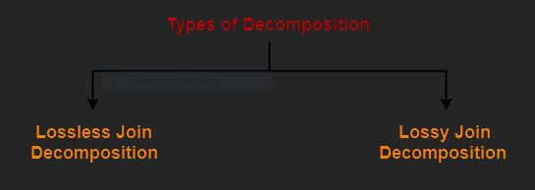
DB Decomposition
Decomposition is a process of dividing a single relation into two or more sub relations.
Decomposition of a relation can be completed in the following two ways-

Slide 121
Lossless Join Decomposition Lossy Join Decomposition
In this ppt, we will learn how to determine whether the decomposition is lossless or lossy.
Determining Whether Decomposition Is Lossless Or Lossy-
Consider a relation R is decomposed into two sub relations R₁ and R₂.
Then,
If all the following conditions satisfy, then the decomposition is lossless.
If any of these conditions fail, then the decomposition is lossy.
Condition-01:
Union of both the sub relations must contain all the attributes that are present in the original relation R.
Thus,
R₁ ∪ R₂ = R

Slide 122
Condition-02:
Intersection of both the sub relations must not be null.
In other words, there must be some common attribute which is present in both the sub relations.
Thus,
R1 ∩ R2 ≠ ∅

Slide 123
Condition-03:
Intersection of both the sub relations must be a super key of either R₁ or R₂ or both.
Thus,
R₁ ∩ R₂ = Super key of R₁ or R₂

Slide 124
PRACTICE PROBLEMS BASED ON DETERMINING WHETHER DECOMPOSITION IS LOSSLESS OR LOSSY-
Problem-01:
Consider a relation schema R ( A , B , C , D ) with the functional dependencies A → B and C → D. Determine whether the decomposition of R into R₁ ( A , B ) and R₂ ( C , D ) is lossless or lossy.
Solution-
To determine whether the decomposition is lossless or lossy, We will check all the conditions one by one.
If any of the conditions fail, then the decomposition is lossy otherwise lossless.
Condition-01:
According to condition-01, union of both the sub relations must contain all the attributes of relation R.

Slide 125
So, we have-
R₁ ( A , B ) ∪ R₂ ( C , D )
= R ( A , B , C , D )
Clearly, union of the sub relations contain all the attributes of relation R.
Thus, condition-01 satisfies.
Condition-02:
According to condition-02, intersection of both the sub relations must not be null.
So, we have-R₁ ( A , B ) ∩ R₂ ( C , D )
= Φ
Clearly, intersection of the sub relations is null.
So, condition-02 fails.
Thus, we conclude that the decomposition is lossy.

Slide 126
Problem-02:
Consider a relation schema R ( A , B , C , D ) with the following functional dependencies-
A → B
B → C
C → D
D → B
Determine whether the decomposition of R into R₁ ( A , B ) , R₂ ( B , C ) and R₃ ( B , D ) is lossless or lossy.
Solution-Consider the original relation R was decomposed into the given sub relations as shown-

Slide 127
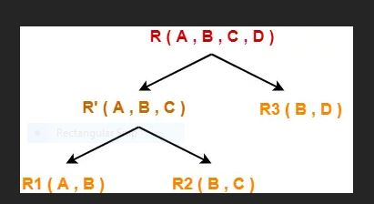

Slide 128
Decomposition of R(A, B, C, D) into R'(A, B, C) and R₃(B, D)-
To determine whether the decomposition is lossless or lossy,
We will check all the conditions one by one.
If any of the conditions fail, then the decomposition is lossy otherwise lossless.
Condition-01:
According to condition-01, union of both the sub relations must contain all the attributes of relation R.
So, we have-
R‘ ( A , B , C ) ∪ R₃ ( B , D )
= R ( A , B , C , D )
Clearly, union of the sub relations contain all the attributes of relation R.
Thus, condition-01 satisfies.
Condition-02:
According to condition-02, intersection of both the sub relations must not be null.
So, we have-
R‘ ( A , B , C ) ∩ R₃ ( B , D )
= B
Clearly, intersection of the sub relations is not null.
Thus, condition-02 satisfies.

Slide 129
Condition-03:
According to condition-03, intersection of both the sub relations must be the super key of one of the two sub relations or both.
So, we have-R‘ ( A , B , C ) ∩ R₃ ( B , D )
= B
Now, the closure of attribute B is-
B⁺ = { B , C , D }
Now, we see-
Attribute ‘B’ can not determine attribute ‘A’ of sub relation R’.
Thus, it is not a super key of the sub relation R’.
Attribute ‘B’ can determine all the attributes of sub relation R₃.
Thus, it is a super key of the sub relation R₃.
Clearly, intersection of the sub relations is a super key of one of the sub relations.
So, condition-03 satisfies.
Thus, we conclude that the decomposition is lossless.
Decomposition of R'(A, B, C) into R₁(A, B) and R₂(B, C)-
To determine whether the decomposition is lossless or lossy,
We will check all the conditions one by one.
If any of the conditions fail, then the decomposition is lossy otherwise lossless.
Condition-01:
According to condition-01, union of both the sub relations must contain all the attributes of relation R’.
So, we have-
R₁ ( A , B ) ∪ R₂ ( B , C )
= R’ ( A , B , C )
Clearly, union of the sub relations contain all the attributes of relation R’.
Thus, condition-01 satisfies.
Condition-02:
According to condition-02, intersection of both the sub relations must not be null.
So, we have-
R₁ ( A , B ) ∩ R₂ ( B , C )
= B
Clearly, intersection of the sub relations is not null.
Thus, condition-02 satisfies.

Slide 130
Condition-03:
According to condition-03, intersection of both the sub relations must be the super key of one of the two sub relations or both.
So, we have-
R₁ ( A , B ) ∩ R₂ ( B , C )
= B
Now, the closure of attribute B is-
B⁺ = { B , C , D }
Now, we see-
Attribute ‘B’ can not determine attribute ‘A’ of sub relation R₁.
Thus, it is not a super key of the sub relation R₁.
Attribute ‘B’ can determine all the attributes of sub relation R₂.
Thus, it is a super key of the sub relation R₂.
Clearly, intersection of the sub relations is a super key of one of the sub relations.
So, condition-03 satisfies.
Thus, we conclude that the decomposition is lossless.
Conclusion-
Overall decomposition of relation R into sub relations R₁, R₂ and R₃ is lossless.

Slide 131
Original Table: Employee
EmpID | Name | DeptID | DeptName
101 | Alice | D1 | HR
102 | Bob | D2 | Finance
103 | Carol | D1 | HR

Slide 132
Decomposed Tables: 1. Employee_Info
EmpID | Name | DeptID
101 | Alice | D1
102 | Bob | D2
103 | Carol | D1

Slide 133
2. Department
DeptID | DeptName
D1 | HR
D2 | Finance

Slide 134
Join (on DeptID) → Result:
EmpID | Name | DeptID | DeptName
101 | Alice | D1 | HR
102 | Bob | D2 | Finance
103 | Carol | D1 | HR

Slide 135
We get back the original table. ✅ This is a lossless decomposition

Slide 136
Lossy Decomposition ExampleOriginal Table: Student
StudentID | Name | Course | Instructor
S1 | Ramesh | Math | Prof. A
S2 | Suresh | Science | Prof. B

Slide 137
Decomposed Tables:1. Student_Info
StudentID | Name
S1 | Ramesh
S2 | Suresh

Slide 138
Course | Instructor
Math | Prof. A
Science | Prof. B

Slide 139
Join (No common key) → Result (Cartesian product):
StudentID | Name | Course | Instructor
S1 | Ramesh | Math | Prof. A
S1 | Ramesh | Science | Prof. B
S2 | Suresh | Math | Prof. A
S2 | Suresh | Science | Prof. B

Slide 140
Extra rows appear that didn't exist originally. ❌ This is a lossy decomposition.

